Slide 1
Yes, you need a portfolio!
Shannon Turner
Notes:
As a group, we're going to brainstorm and analyze and explore other great portfolios, we're going to figure out what ours should be, and we're going to sketch it out -- actually on paper -- and lay the foundation for turning that sketch into code. Even if you already have a portfolio site, I think this workshop will be very valuable.

Slide 2
I am woman, Hear Me Code!
Free, beginner-friendly coding classes
Over 2,000 women in DC
Focus on turning students into teachers
hearmecode.com
Notes:
I want to say a few quick words about who I am -- three years ago I started a group called Hear Me Code, an organization that offers free, beginner-friendly coding classes for over 2000 women in DC. Hear Me Code focuses on leadership development, peer mentoring, and turning students into teachers.
If you're interested, I hope you'll join by going to hearmecode.com

Slide 3
Yes, you need a portfolio!
People are Googling your name
Resume, Cover Letter, Portfolio
Tell the world who you are
Notes:
When people Google your name, what do you want them to find?
When applying for a new job, we put so much time and attention into crafting our resume, tailoring a cover letter to each organization. I think of my portfolio site as an extension of my resume, as something better than my resume - it's where I can show projects I've created and people can click through and see them in action. They can see my work, they know what I've done. And actually, none of my day-job work is on my portfolio site! My resume has that covered; my portfolio is bonus!

Slide 4
My portfolio helps me
I'm proud of my work! I want to show it off!
It's how strangers contact me
Freelance opportunities
Media interviews
Job interviews
Notes:
So all those reasons are why I have a portfolio, my portfolio also helps me tell the world who I am and the projects I've built!

Slide 5
What makes a good portfolio?
Notes:
I have a feeling we're all going to have a lot of different answers to this, so let's ask the room: what makes a good portfolio?

Slide 6
What makes a good portfolio?
IT DEPENDS!

Slide 7
What's "good" depends on ...
What are your goals?
Who is your audience?
Notes:
These two questions are SO important! Your portfolio should effectively communicate with your audience and help you reach your goals.

Slide 8
My goals
Show off my projects
Make a name for myself
Bonus: improve my career trajectory
Notes:
These are the goals I had when I set out to create my portfolio site -- what are some of the goals you have?

Slide 9
My audience
Future employers
People I want to work with
People who would be interested in my projects
Notes:
These are the audiences I had in mind when creating my portfolio site -- what are some audiences you can think of that you would like to reach?
Suggest:
Conference organizers (Would you give a talk on X?)

Slide 10
shannonvturner.com
I want my portfolio to clearly communicate:
My professional accomplishments
The types of projects I've created
How to contact me
Notes:
So let's go here to shannonvturner.com, my personal portfolio site, and look this over with a fine-tooth comb. I want to emphasize that while I'm generally happy with my portfolio, you may have different goals than me! I'm including my portfolio first so we can analyze it critically before moving on to other portfolios.

Slide 11
My portfolio has six parts
Introduction / what I'm about
My projects
Projects I've collaborated on / contributed to
Awards I've received
Press Mentions
Preferred ways to contact me
Notes:
So if we skim this really quickly for the design, we see that the site is broken up into six main parts.

Slide 12
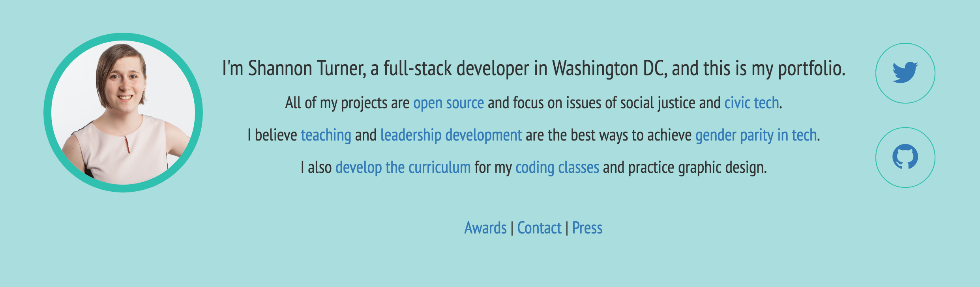
Intro / About Me
Notes:
This section is the first thing people see, so it's really important to get it right! I want to be sure to review the language periodically to make sure it's still accurate, and still the thing I want to be the first thing people read about me!

Slide 13
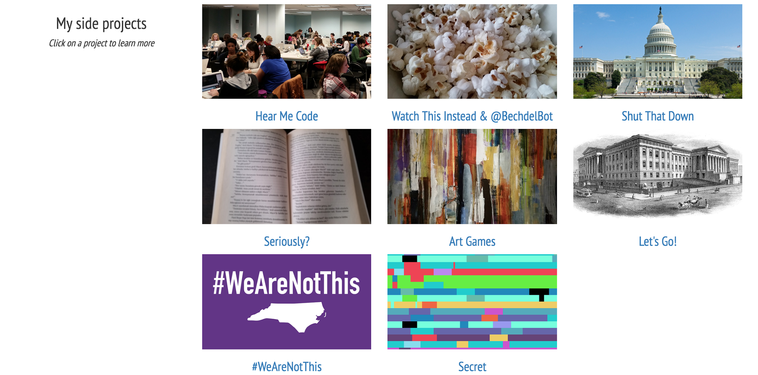
My projects
Notes:
This section is to me, the most important. It's to show my accomplishments and to show what types of projects I've created.

Slide 14
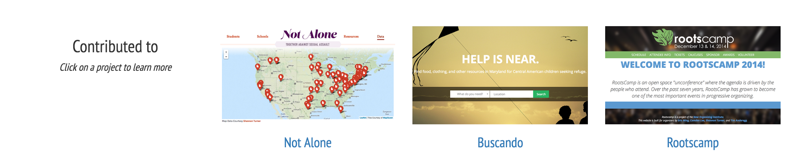
Contributed to
Notes:
So I can't call these projects all my own in the same way as the previous section, but I did contribute to each of these in some way -- like creating the map for NotAlone.gov, doing web development for Buscando, and creating the Rootscamp mobile app in 2014. Like the previous section, this is an important section to show the types of projects I've worked on. But if I were to cut any section, it would probably be this one since it's not super clear what my exact contributions to these projects were.

Slide 15
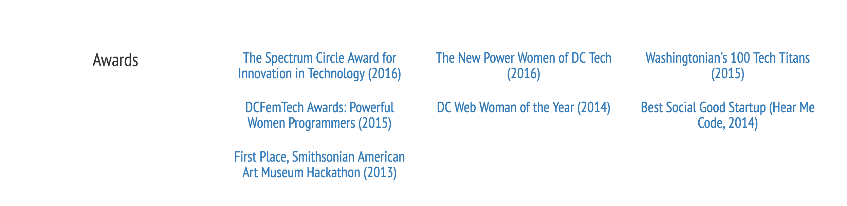
Awards I've received
Notes:
I feel self-conscious about this section because it feels like bragging but at the same time it's important! It gives external validation to my work, and highlights some of my accomplishments.

Slide 16
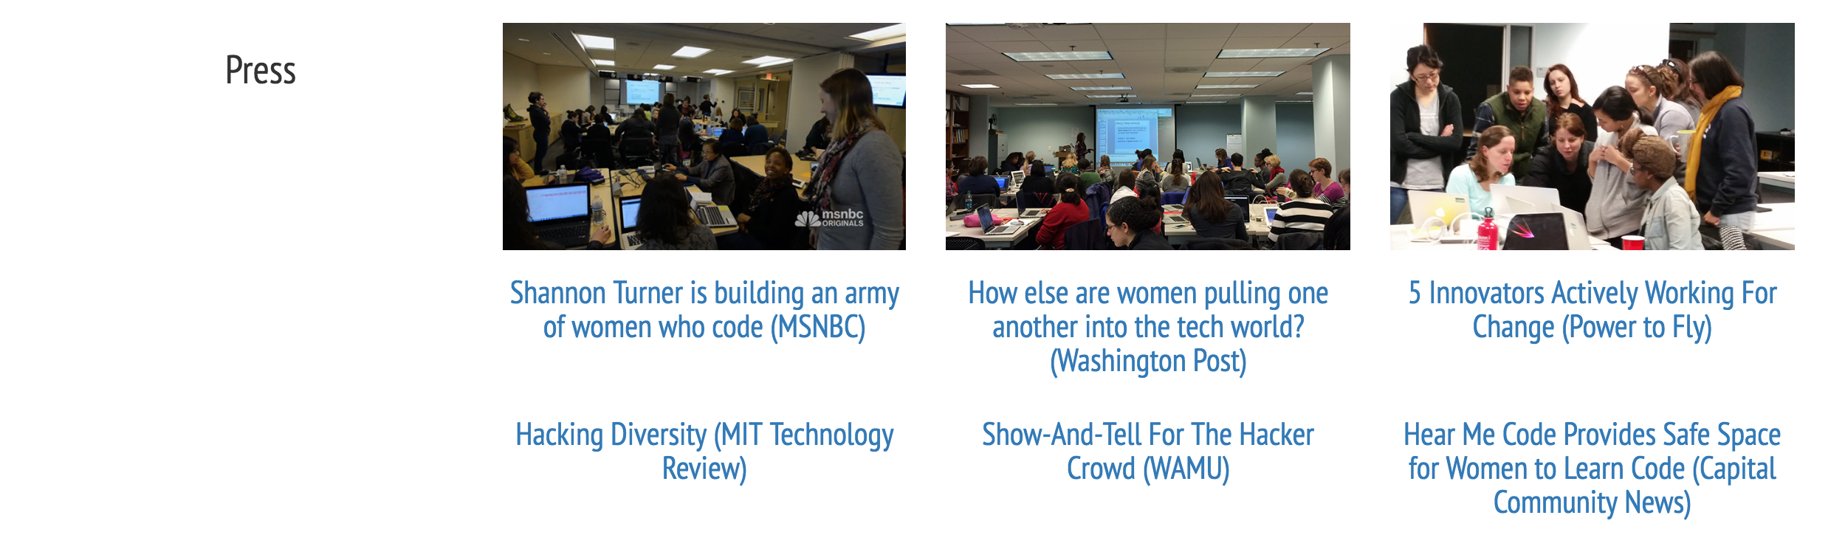
Press coverage
Notes:
Here is a selection of press articles. A previous version of this section had more articles, and a thumbnail for every article, but I ended up deciding it was too much, and pared it down. The three articles at the top are ones in specific I wanted to highlight, and so included thumbnails. Like the awards, the press section provides external validation to my work and highlights my accomplishments.

Slide 17
Preferred ways to contact me
Notes:
Finally, here's the ways I'd prefer you contact me. Originally, I didn't have my email address listed -- but as soon as I added it, I started getting a steady stream of people wanting to chat. Although the prompt suggests that you should contact me to hire me for freelance opportunities, people use that address for general purpose communications.

Slide 18
What I like
Each part contributes meaningfully to my goals
Design is harmonic
Clear and concise
Notes:
Three things I like about my portfolio site

Slide 19
What I can improve
Thumbnails are decorative and don't explain my projects; adding a brief description would make it clearer
It's difficult to tell my precise contributions in the "Contributed to" section
My "email me" prompt might discourage people who are not interested in hiring me for freelance work
Notes:
And three areas of improvement. Keep in mind that just as we are all works in progress, so too are our portfolios!

Slide 20
A tricky problem
Thumbnails are decorative and don't explain my projects; adding a brief description would make it clearer
A previous attempt: http://web.archive.org/web/20150108081850/http://shannonvturner.com/
Notes:
So I've been struggling with this since the beginning of having my portfolio. How can I clearly and concisely communicate what my project is all about? Is the title and a link enough? Right now I kinda have a little bit of a "curiosity gap" going on - what's this sketch of an old building titled "Let's go?" Well, I could click to find out. But in previous versions of my portfolio [see Wayback], I've taken a different approach, by overlaying the title and a brief description on top of a photo or a screenshot. This was great, because it was informative! But it also made the design look very scattershot. There are a lot of different approaches to this problem, and no single right answer!

Slide 21
Let's review some portfolios!
What are the author's goals?
Who is the audience?
What parts of the design do you think are most important?
Notes:
Let's be sure to keep returning to these questions as we review the following set of portfolio sites.

Slide 22
As we review these, let's also ask:
How does the design suggest which information is most important?
How many sections does each portfolio site have? What are they?
Do you have a good sense of the author's professional work?

Slide 23
Some of my favorite portfolio sites
lilydesignberg.com
frostenson.com
camdenlee.com
samihah.co
nguyenist.github.io
Notes:
These are five of my favorite portfolio websites, and I think one of the things I like the most about each of these is the way that they approach the thumbnail vs. description problem that's vexed me so much. But they've also got really great design and content. These are amazing portfolios to emulate!
Let's walk through these portfolio sites together, and take note of the design choices and how each part meaningfully contributes to the author's goals.

Slide 24
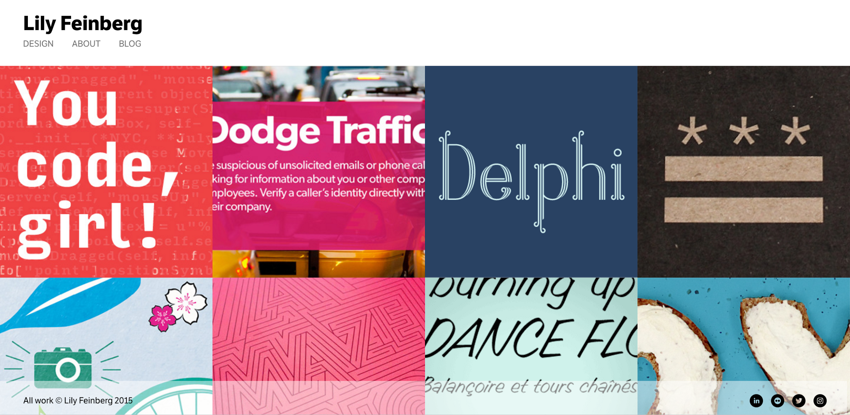
Notes:
I love Lily's design here: the whole width of the screen is used, and each piece of her portfolio is given a square -- there's a lot of color here, and a lot to catch your eye. The use of negative space at the very top draws your eye to Lily Feinberg, she's the one who built this.

Slide 25
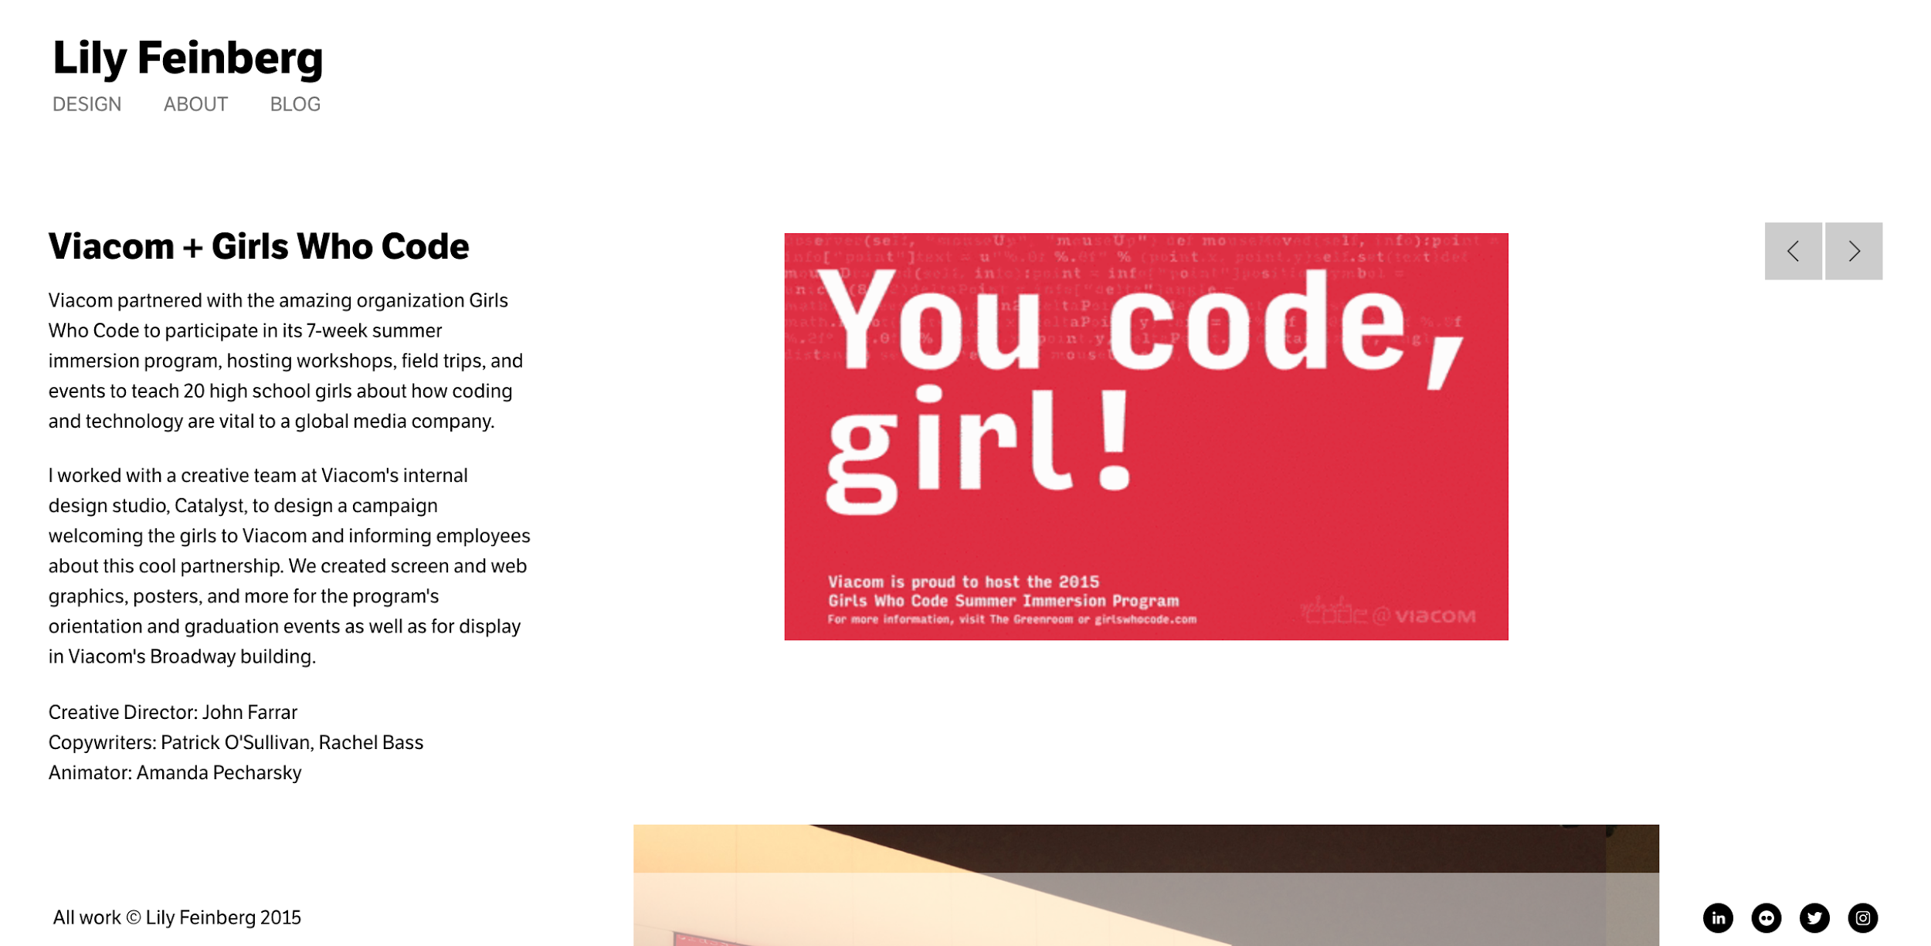
Notes:
Clicking on one of the items takes you to a page that describes each item in much more detail, and shows more photos and pictures. But if you keep scrolling, you'll be back to where you started, so it's very easy to keep clicking around and viewing all of her projects.

Slide 26
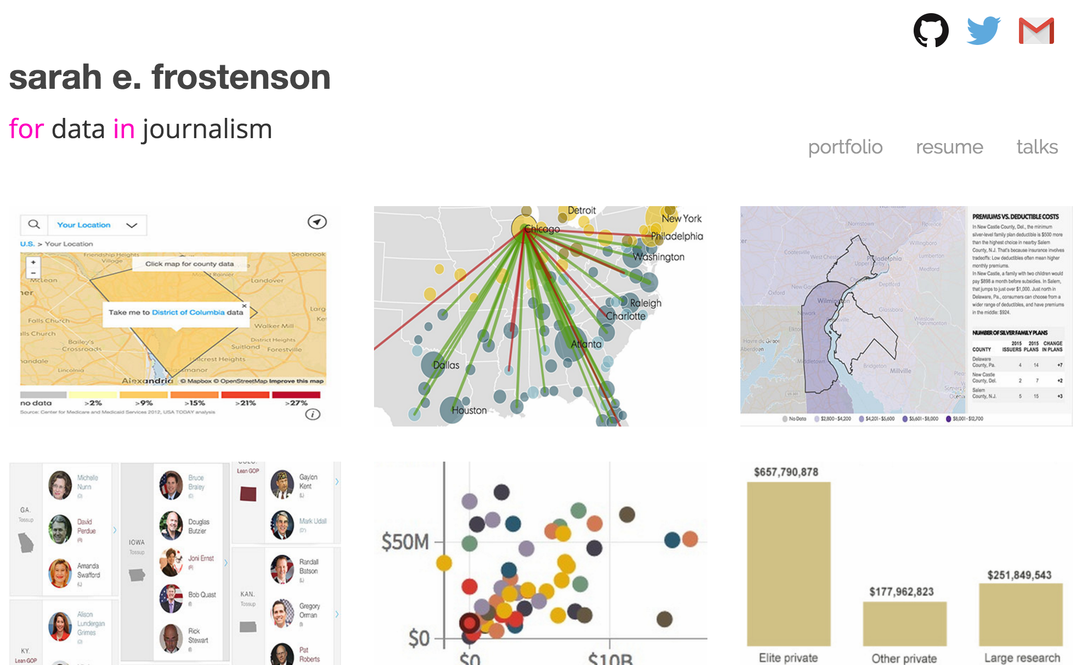
Notes:
Sarah does lots of data visualizations, and I like her tagline -- it's a nice coding pun that reinforces what she does -- coding, data, and journalism. She solves the problem of "what is this map of the south with all of the lines converging in Chicago" by having descriptive text that appears when you hover over the image.

Slide 27
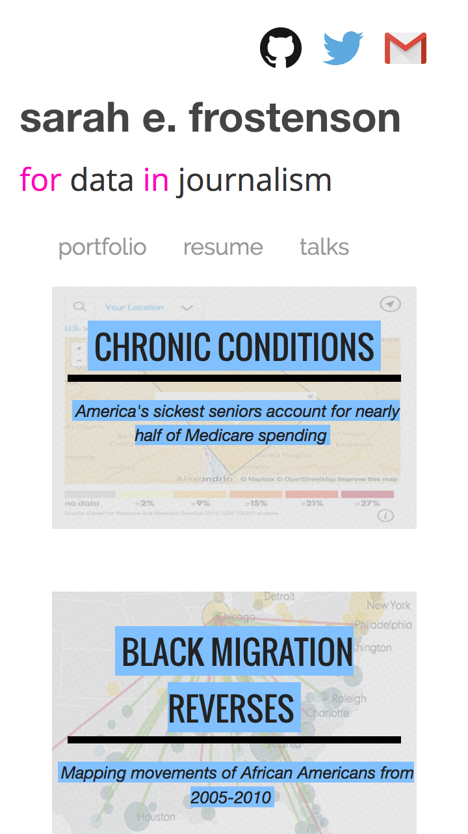
Notes:
You can't really hover on a phone, though.
But Sarah thought of everything! On a phone, the hover text is shown automatically, so you know exactly what you're about to click on.

Slide 28
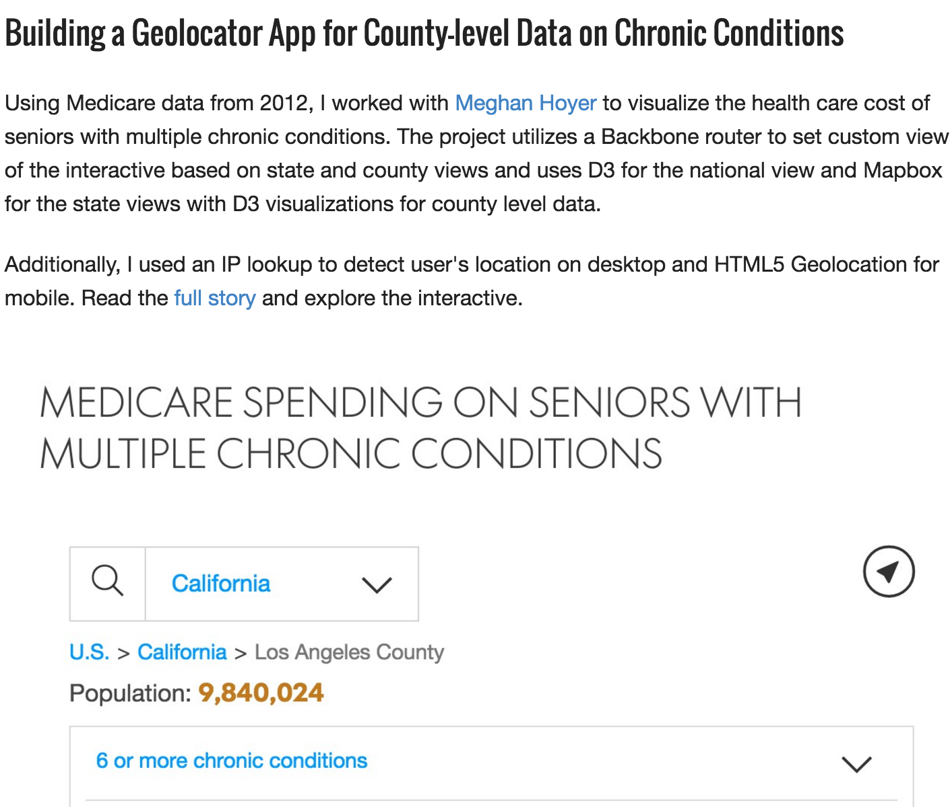
Notes:
And each item has a page that you can explore in much greater detail.

Slide 29
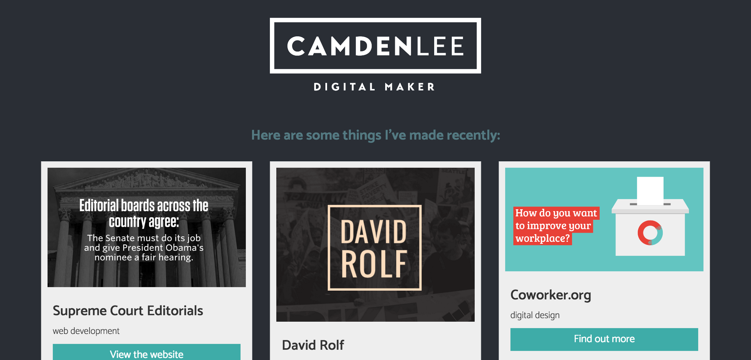
Notes:
Camden has a personal logo here, showing off his design skills, and a neat title: Digital Maker. There's really good use of color, with the high contrast and low contrast and and negative space too.

Slide 30
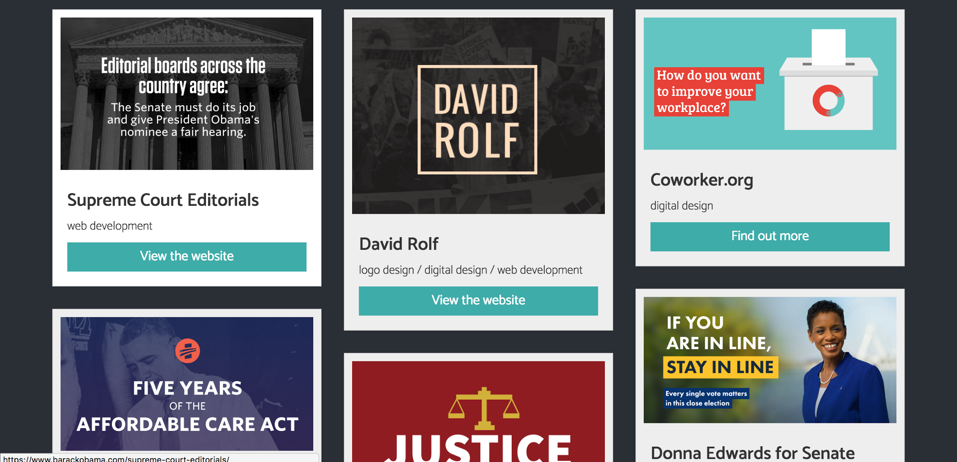
Notes:
It's got kind of like a Pinterest-style layout, which is different than we saw with my portfolio, Lily's, and Sarah's. The three of ours were all uniform squares or rectangles, this one is just different enough to catch your eye. Each screenshot gives you an idea of what the project is about, and I think what I like most is he says exactly how he contributed to each project. If I keep my "Contributed to" section, I think I'll take a page out of Camden's book and describe what it is I've done for each of those projects.

Slide 31
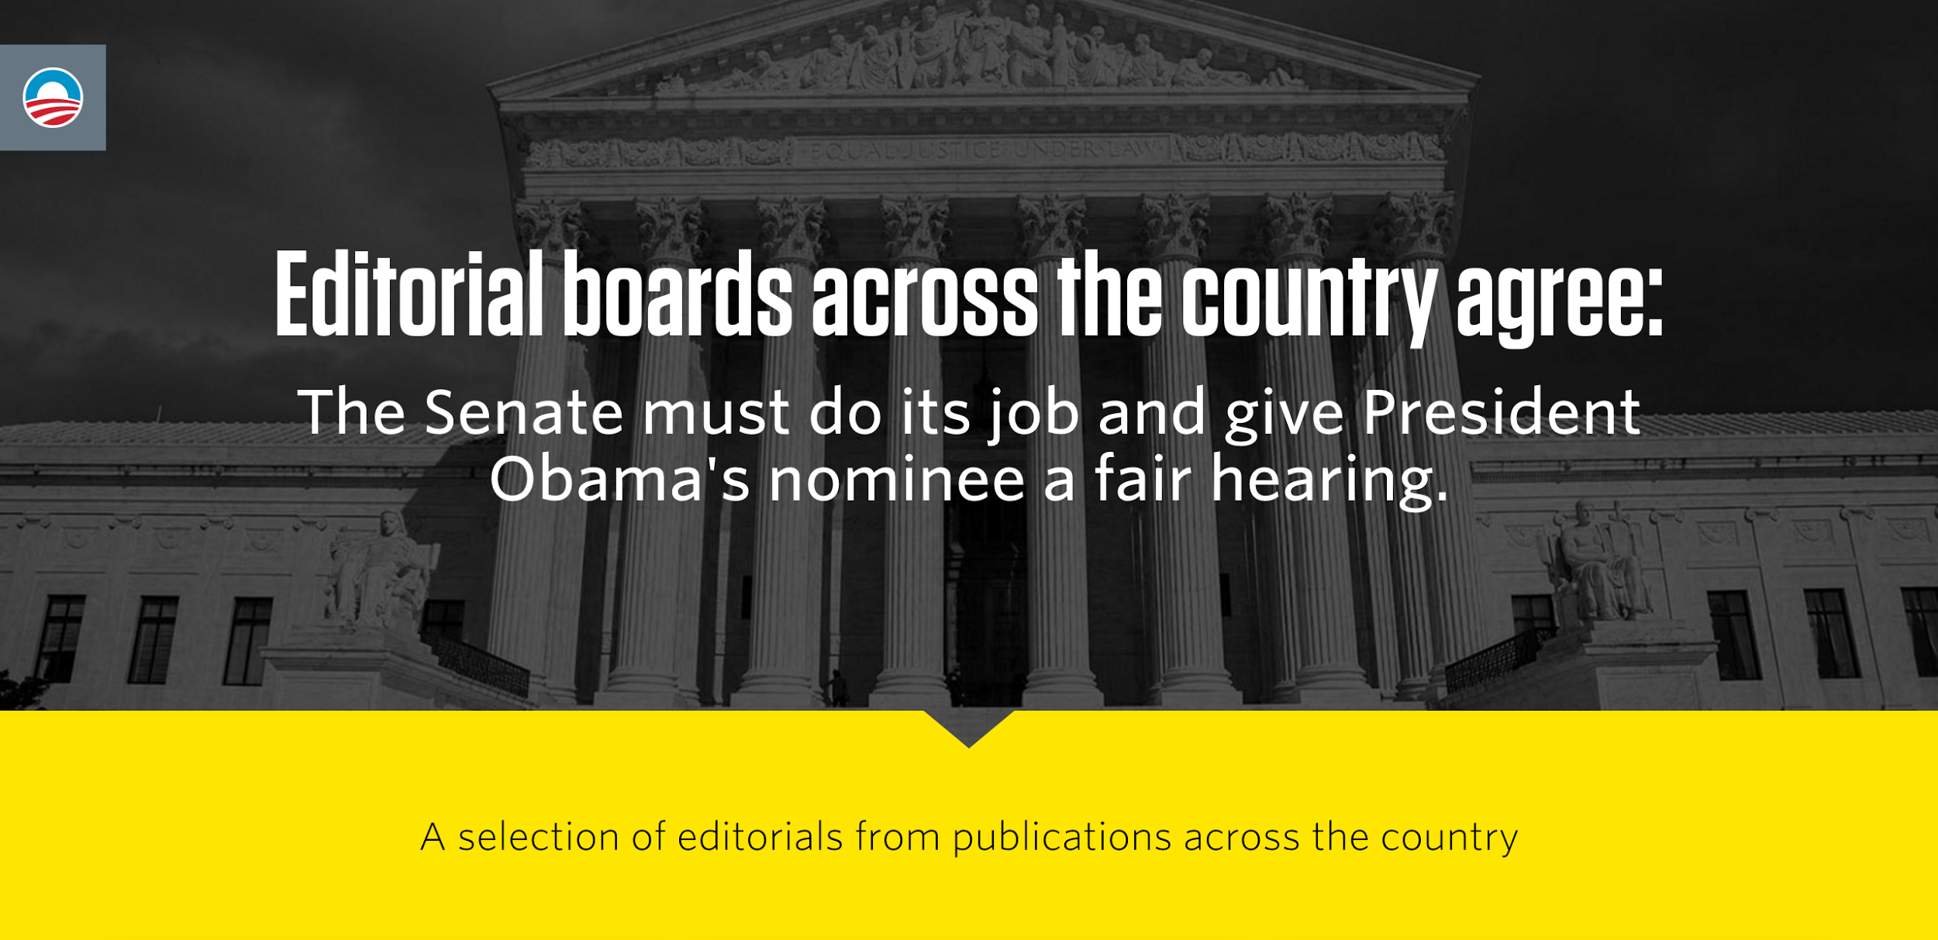
Notes:
And when you go to each link in Camden's page, it takes you to the actual website he's built, similar to my site, rather than the descriptions we saw in Lily's and Sarah's. There's no right answer here -- it comes down to personal style and design choices!

Slide 32
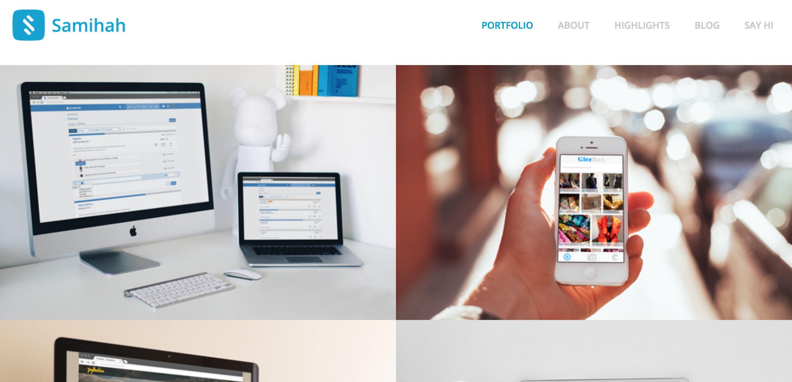
Notes:
Here's Samihah's portfolio -- again, notice the personal logo and the full-width layout similar to Lily's.

Slide 33
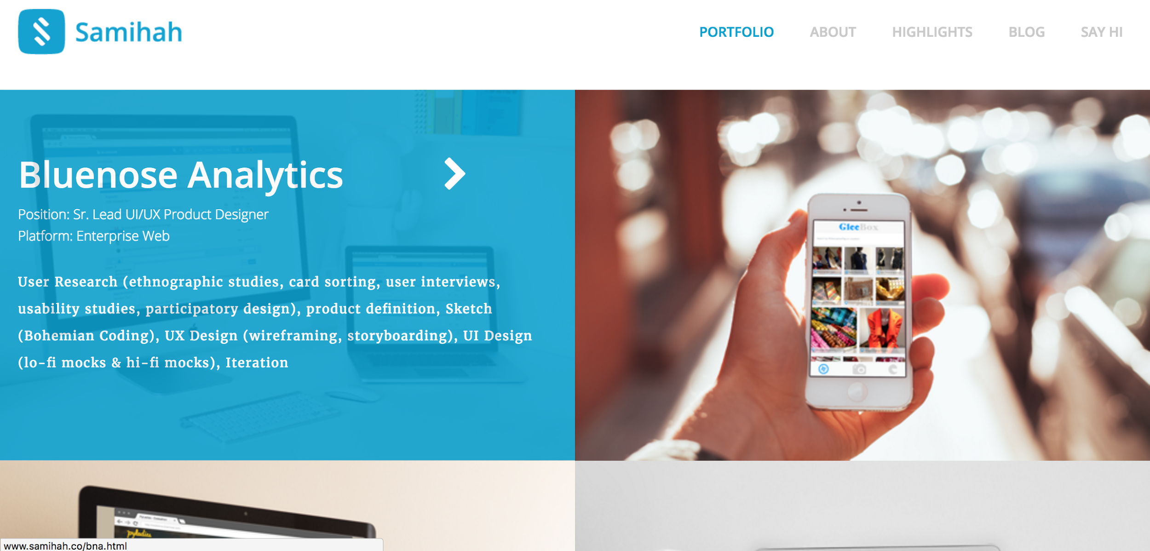
Notes:
And hovering over each item gives a pretty full description, similar to Sarah's portfolio. Like we saw in Camden's portfolio, this also describes how Samihah contributed to the success of each project, so we see here that she was the Senior Lead UI/UX Product Designer. I especially like how the color overlaid covers the full image, and uses the color scheme of her site.

Slide 34
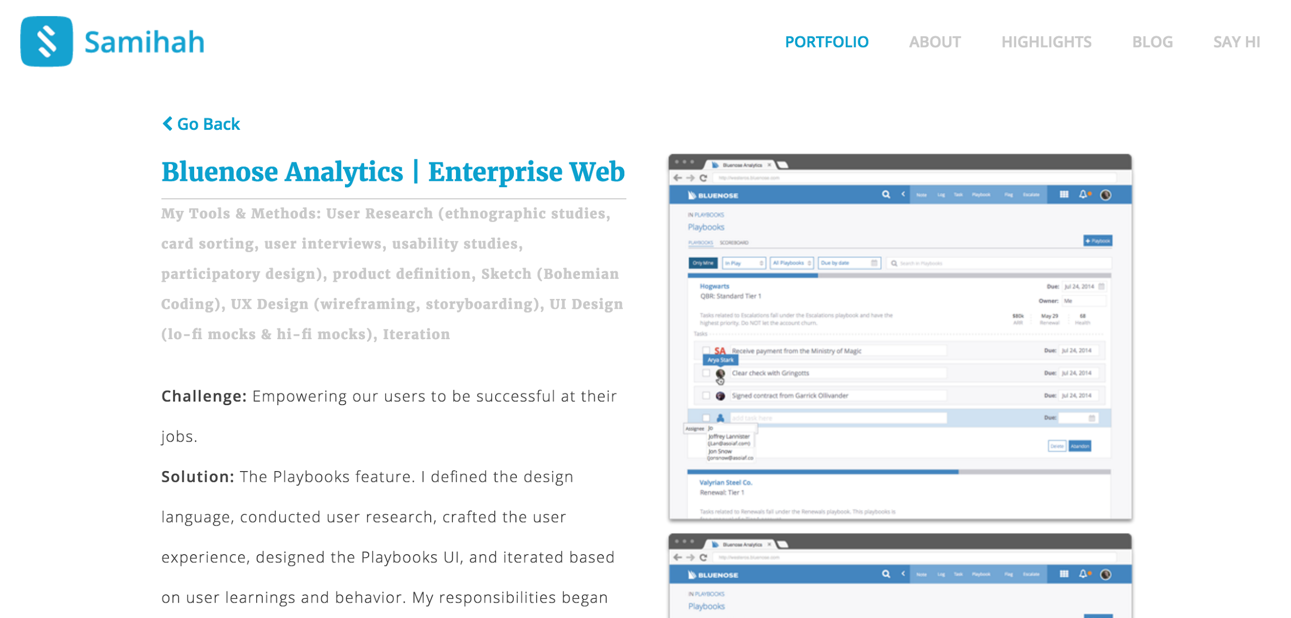
Notes:
Similar to Lily and Sarah's portfolios, clicking on a portfolio item gives a description and some screenshots. What's interesting here is I like how she's outlined specific pieces like the "Challenge" and the "Solution"

Slide 35
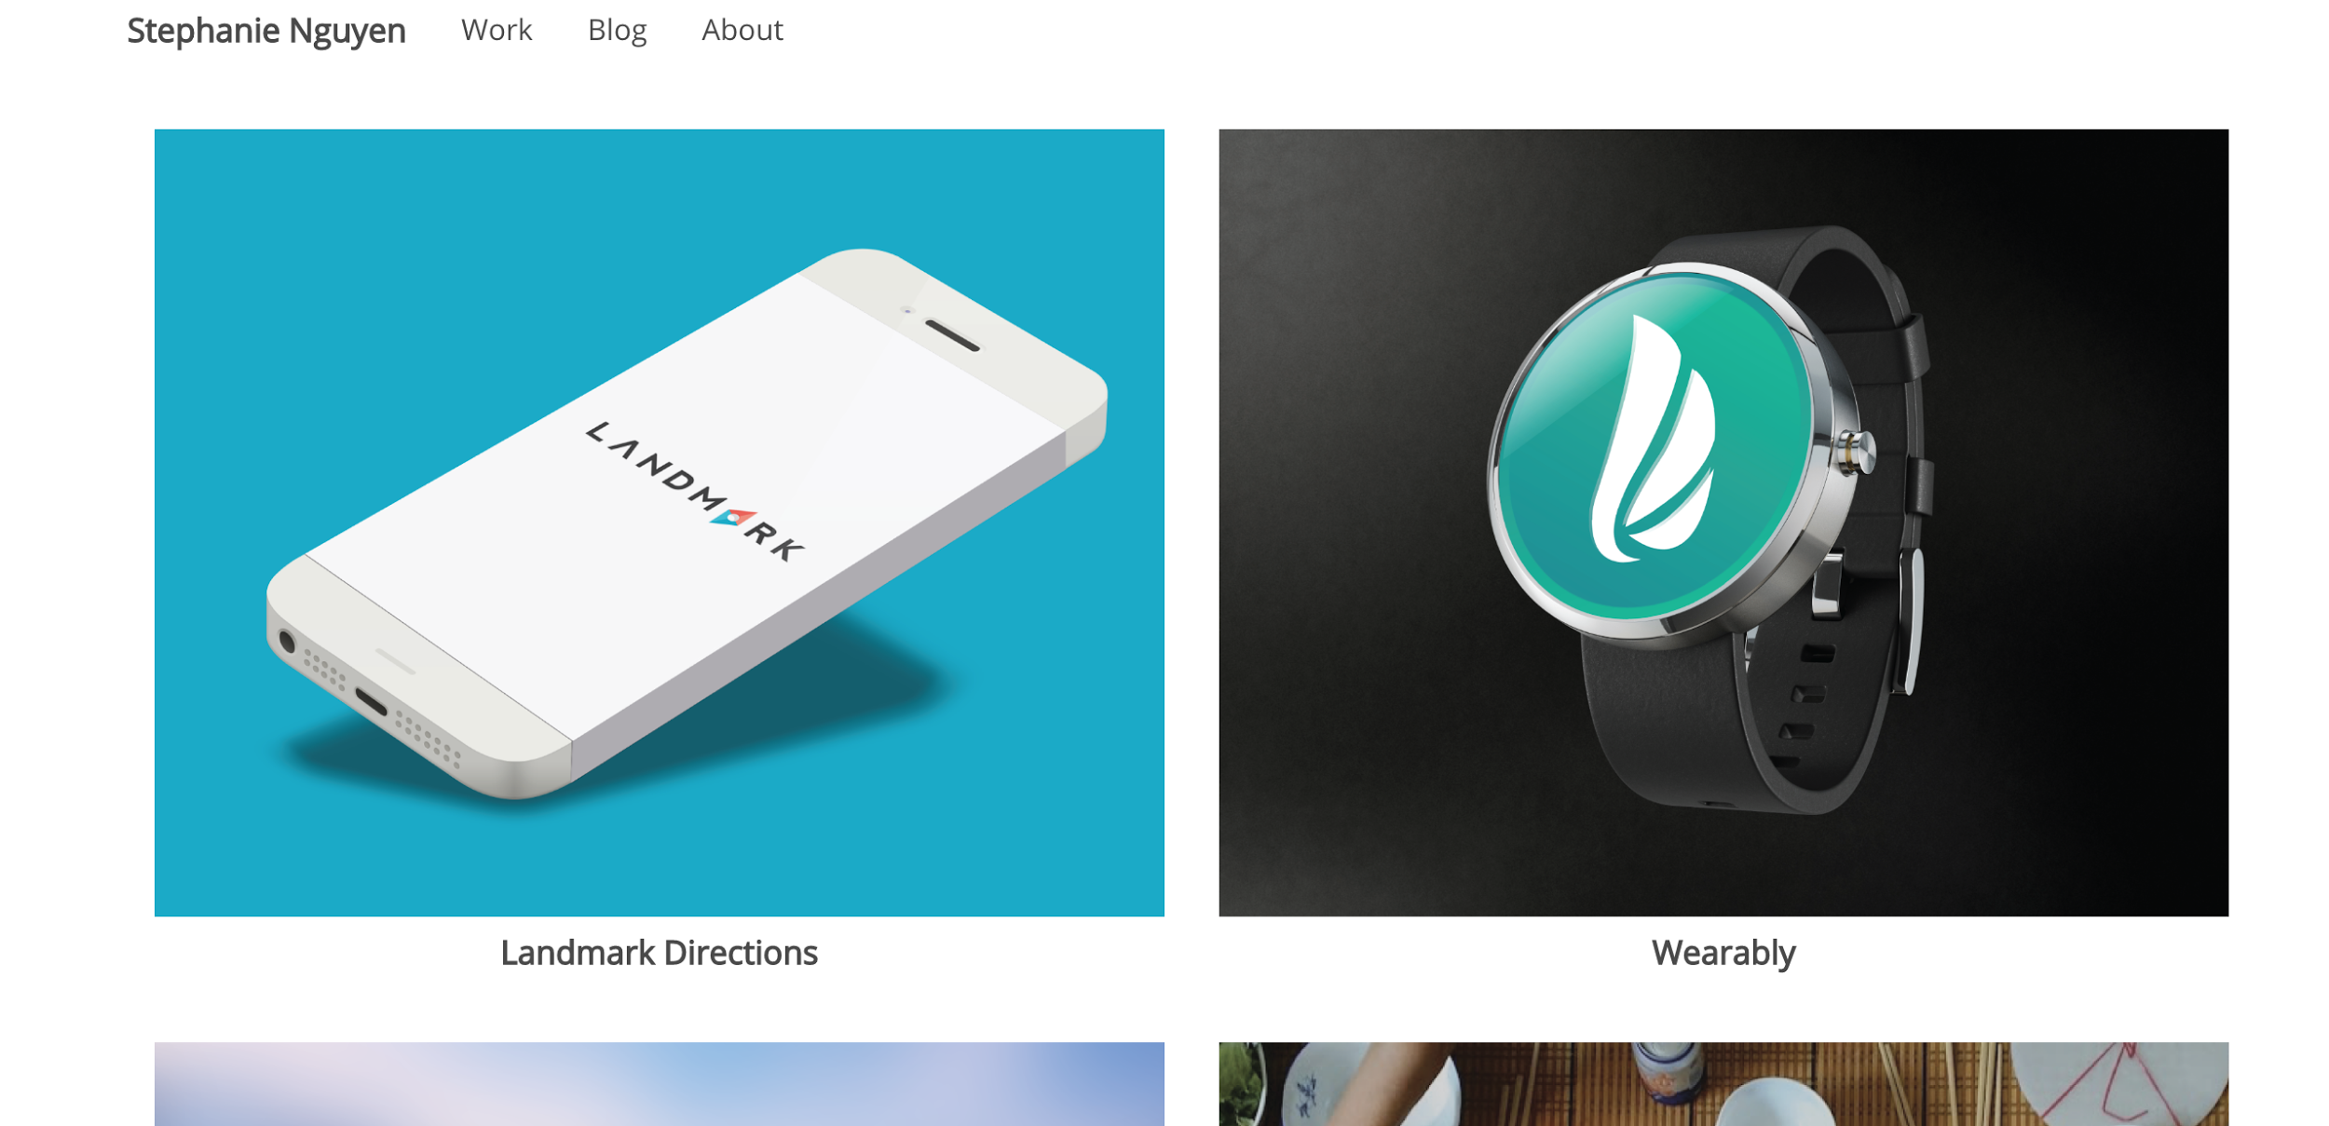
Notes:
Steph's designs are very clean and intuitive, with generous use of negative space to pull you in to the thing she's trying to get you to focus on, so it's no surprise that shows through in her portfolio site.

Slide 36
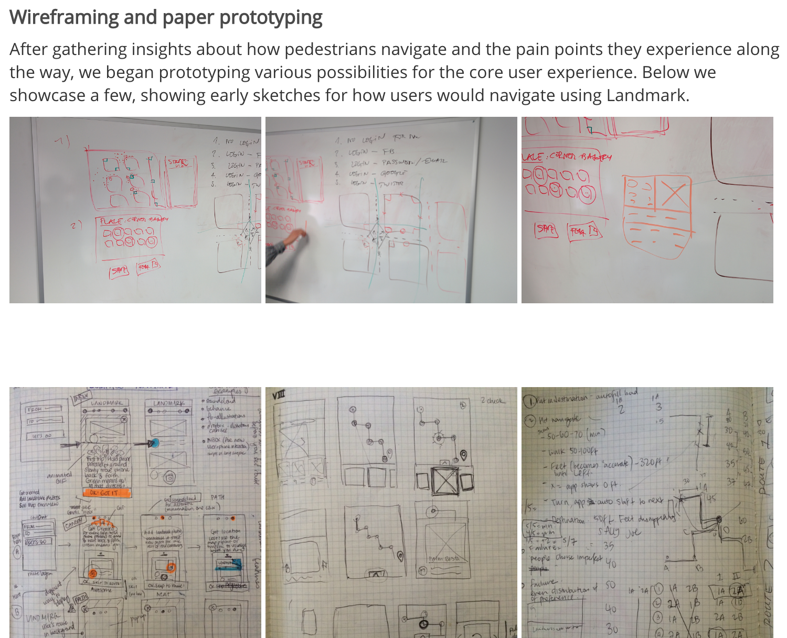
Notes:
What I find really interesting here, is each of Steph's portfolio items goes into super heavy detail about her process of working. It's not just about "hey, I built this thing," but it's also "here's how I built this, here's how I work, here's my thought process that goes into this." Which for a designer, is especially helpful and interesting. I'm also a huge fan of sketching things out -- on paper -- before even writing a single line of code. Planning is important!

Slide 37
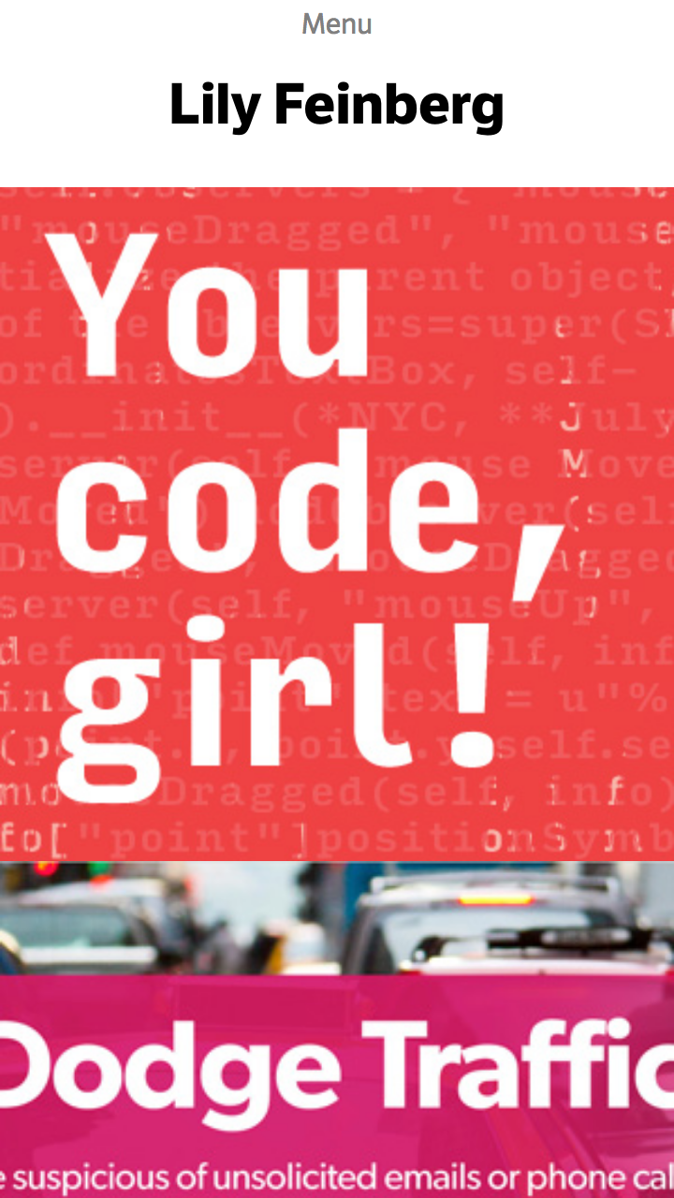
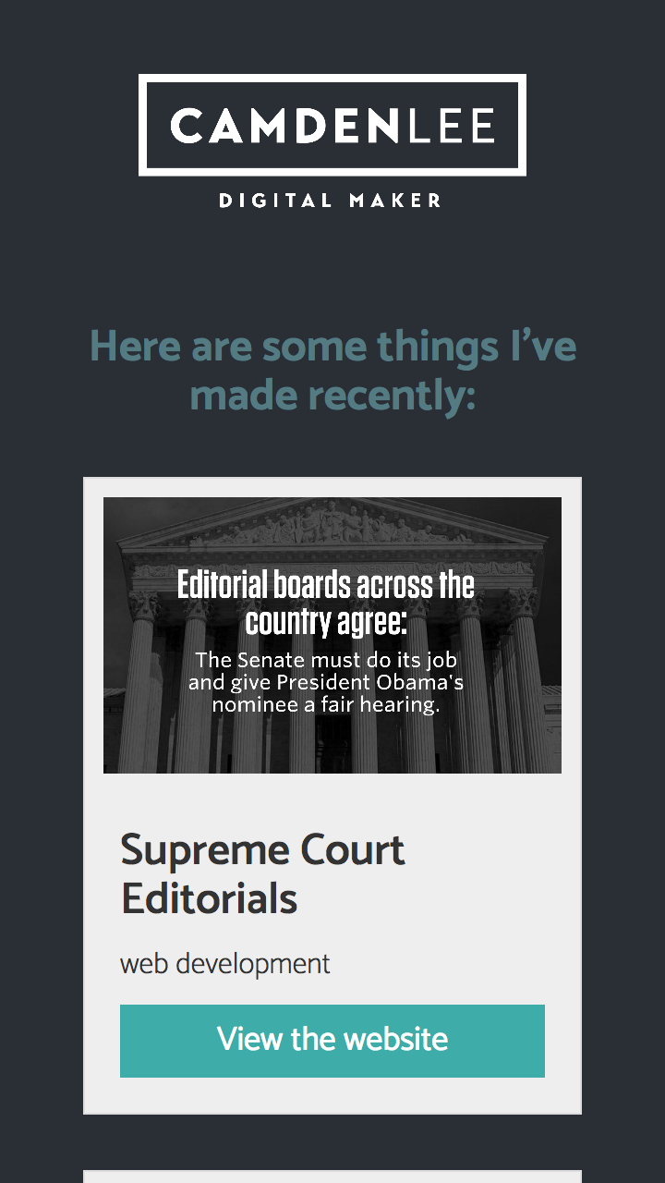
Notes:
One thing I should mention is all five of these sites look lovely on mobile. Designing for mobile shouldn't be an afterthought -- a huge percentage of web traffic is on smartphones and tablets -- and it's not just about shrinking your content down, either. It's often about making smart design choices, hiding some content, moving things around -- and like Sarah's example here, working around the limitations of mobile.

Slide 38
Let's start our portfolio
https://github.com/hearmecode/portfolio
I created a portfolio starter that has a lot of boilerplate already done for you.
Notes:
Take time to walk folks through downloading this, especially for folks unfamiliar with GitHub.
Be sure to go through the boilerplate and talk through what it means.

Slide 39
Some assembly required
If you code your own portfolio site, that's great!
But sites like SquareSpace are a great way to design a beautiful portfolio site if you don't want to code your own site.
Notes:
I think it's extremely valuable to be fluent in HTML and CSS -- and I highly recommend it. But some of the prettiest websites I've seen were designed in SquareSpace. So if you don't have fluency in HTML and CSS, don't fret!

Slide 40
Designer's best friends
https://color.adobe.com/
http://paletton.com/
https://coolors.co
https://color.hailpixel.com/
http://subtlepatterns.com/
Notes:
I wanted to share some resources that I've found to be very helpful.
Several of these will let you pick colors that go well together. Whether you're a master in color theory or just want to see what goes well with your favorites, you've got a lot of choices!
Subtlepatterns is one of my favorites for when you need a very subtle textured background for one of your projects.

Slide 41
Designer's best friends
https://fonts.google.com/
https://www.fontsquirrel.com/
http://fontawesome.io/
http://favicon.cc
Notes:
Color choices and font choices can have two of the most immediately noticeable impacts on your overall design. So we've already explored some great ways to find colors that work well together; now we're going to take a look at some tools that will help us choose fonts that we enjoy.
Don't go overboard with different fonts though! Two is great, and three is fine, but any more than that and your design can look a little scattered!
The third link, Font Awesome, is an icon set with hundreds of icons to choose from -- this is especially useful if you're designing something with buttons, like a menu.
The final link on here is a way to generate a Favicon, or the tiny little picture that appears when you bookmark a site and on each browser tab.

Slide 42
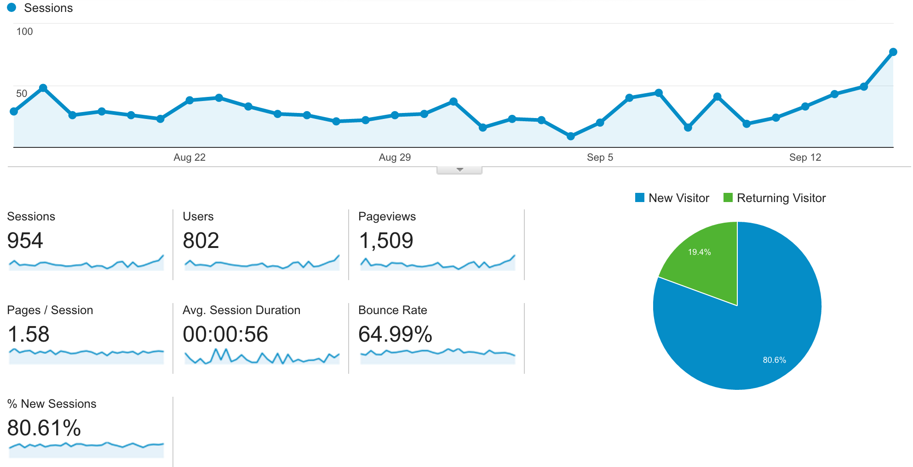
Google Analytics
Notes:
Before you launch any web project, be sure to connect it up to Google Analytics so you can track how many people came to your site and other interesting stats! Even if you're don't care about the numbers, digging deeper into the analytics can give you insight into how people are finding your site, how people are using it, which devices they're visiting on, which pages they care about, and sometimes even where they get stuck. For example, if nobody is visiting a page on your website you really want people to see: why is that? With Google Analytics, you can recognize the problem and make your content more prominent.

Slide 43
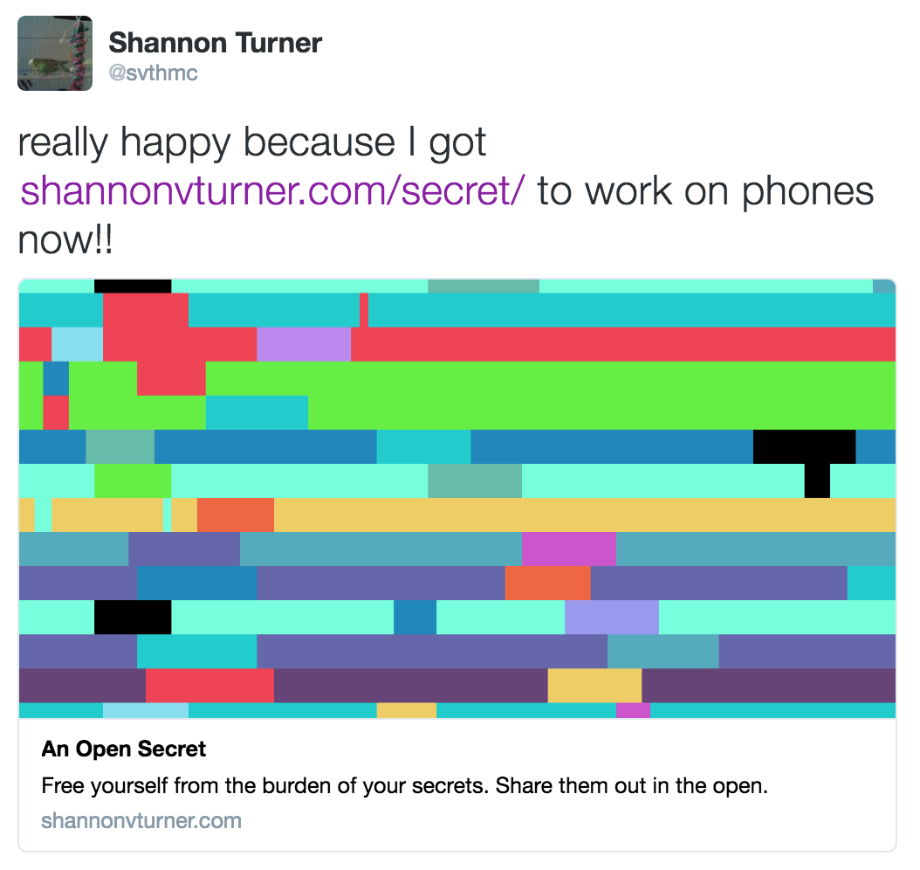
Social Media meta tags
Notes:
Another important thing to do when setting up your site is to set up the meta tags for social media like Facebook and Twitter. Here's an example of how all I had to do in my tweet was link to one of my projects -- and Twitter pulls the meta tags to create the shareable picture, the title, and the description -- all embedded in my tweet. Doing this makes it so much easier for people to share your content, and it's easy to do because the meta tags are all set up in the provided portfolio starter, you just need to fill them in with your content.

Slide 44
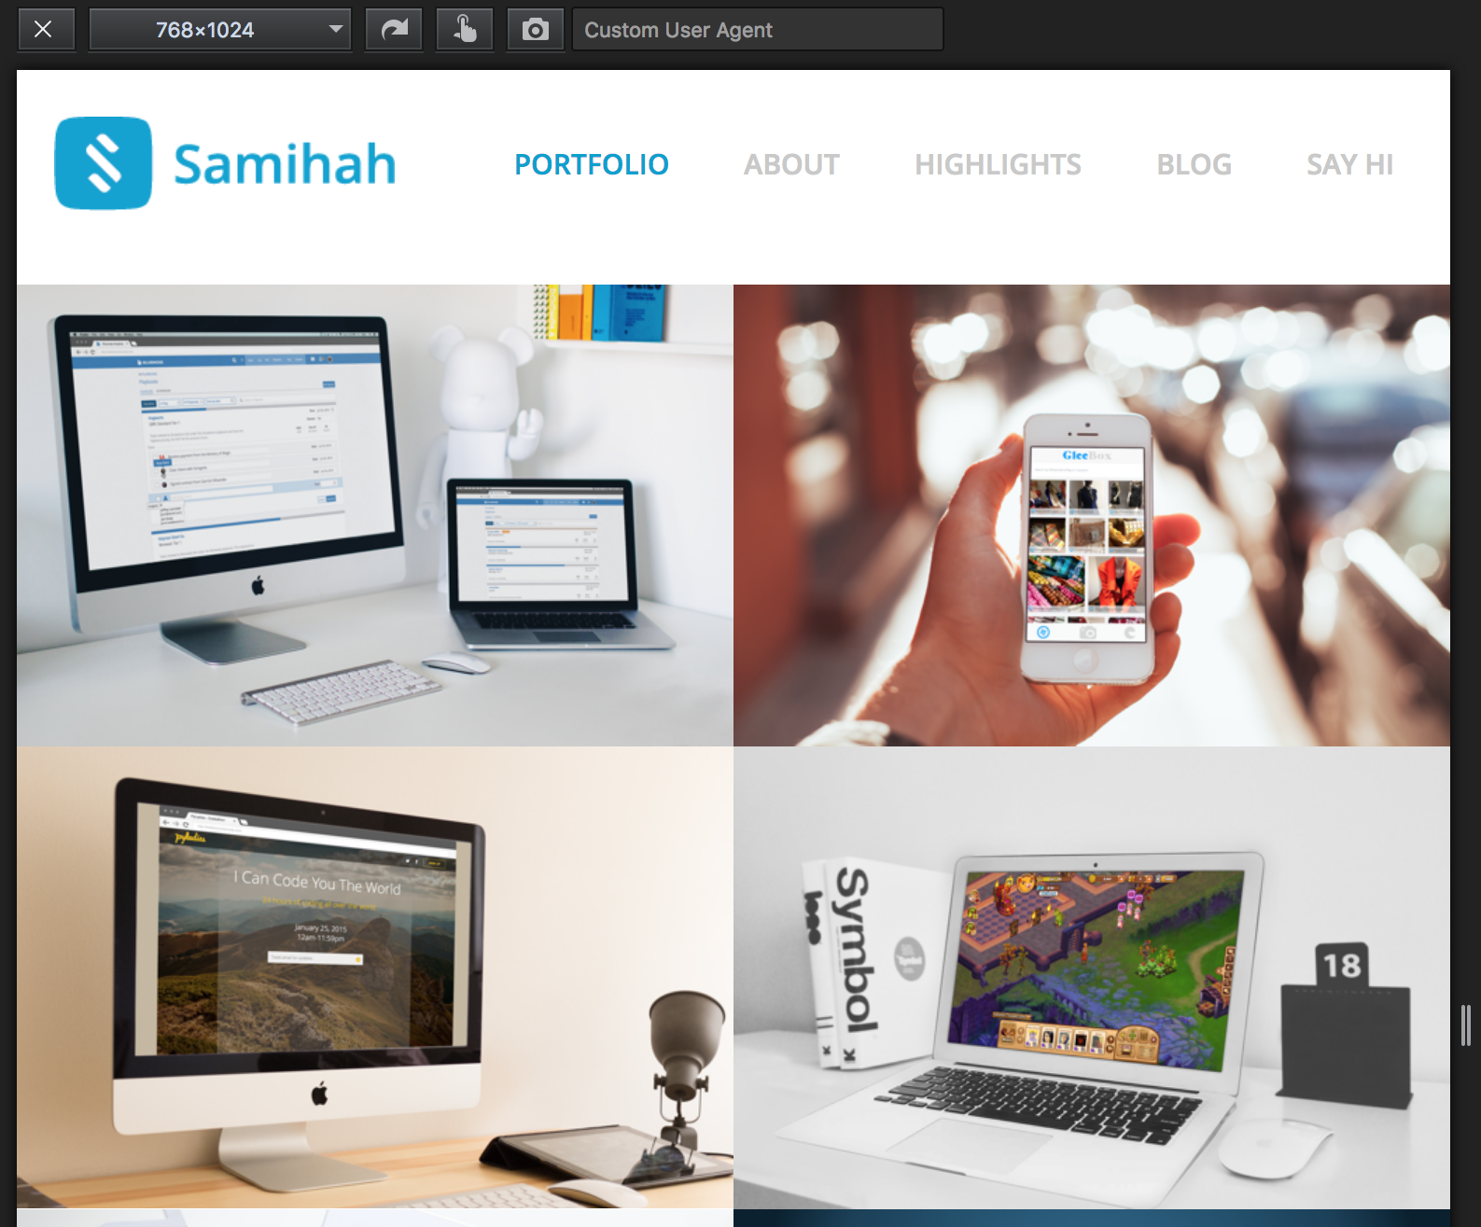
Responsive Design View
Notes:
Firefox has this amazing feature called Responsive Design View, which lets you adjust the size of your browser window to simulate a number of differently-sized devices. So it's an easy way to test your site and see "what would this look like on a phone? Or a tablet?" There are a lot of built-in sizes, but you can also customize the sizes as you wish. It's available in Tools > Web Developer > Responsive Design View.

Slide 45
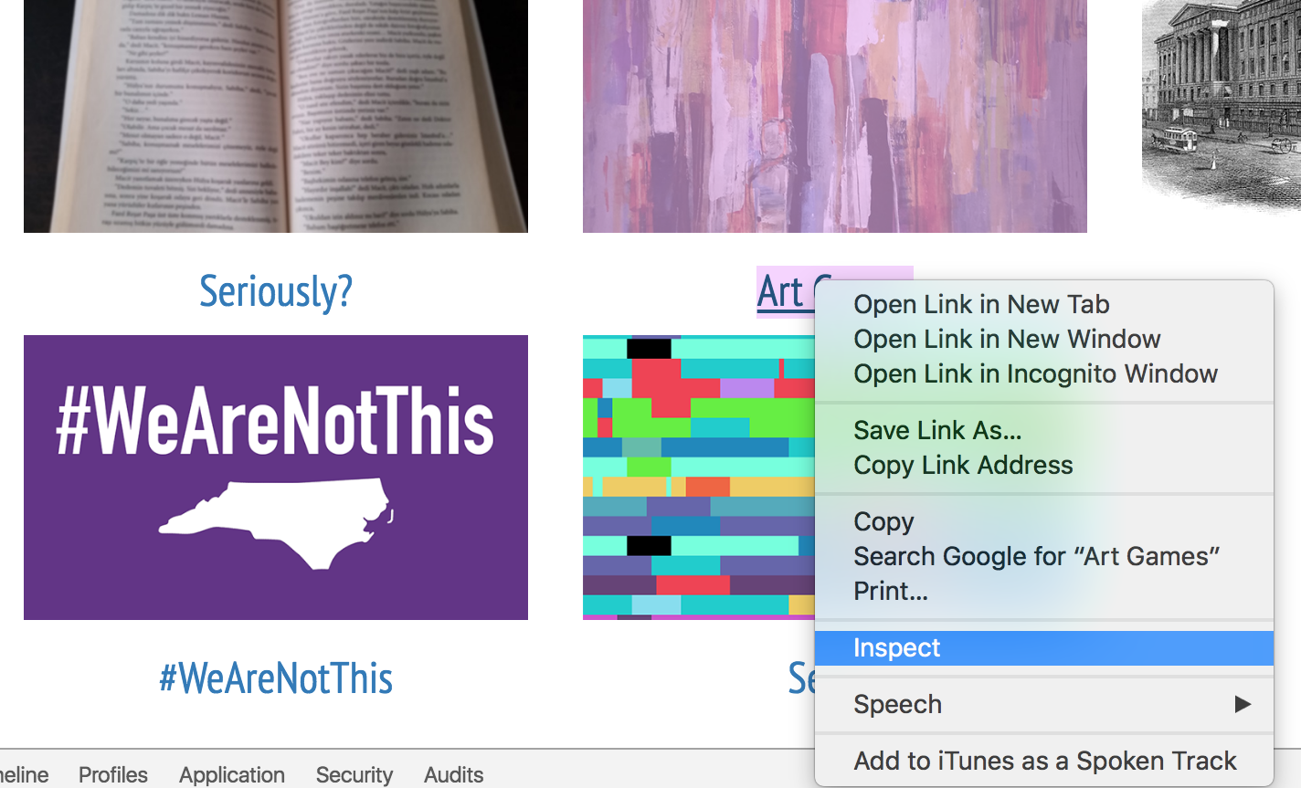
Inspect Element
Notes:
Both Firefox and Chrome let you easily inspect and make changes to any HTML element you like. Right click on an element, like this link, and go to Inspect.

Slide 46
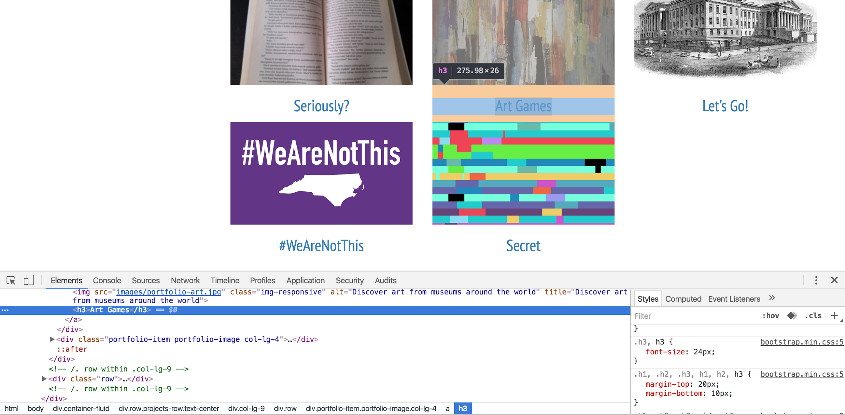
Use this to test your CSS!
Notes:
A window will dock that shows you the HTML source of what you're inspecting, and also allows you to change the HTML or CSS of the page on the fly. This is perfect for testing your CSS! Remember this! You know, I've decided I want a bit of margin between these two rows. How much? Well, I could guess how much I think would look good, save it, and reload the page -- or I could inspect element, adjust it pixel by pixel and see my changes in real time, and when I'm happy with the result, then make the change in my file. Let's do this now.

Slide 47
Bootstrap
Bootstrap is a design framework that looks great and makes it easy to make your website look great at any size!
http://getbootstrap.com/
Notes:
There is a TON of documentation on Bootstrap, and it's actually pretty good documentation that shows you the HTML code and the different kinds of elements it creates from it. Bootstrap is the most popular design framework out there, and there's good reason for it.

Slide 48
The Grid!
Each container is divided into 12 columns
Each column is 100% / 12 columns = 8.33% wide
Containers can be nested
Notes:
The grid system is key to how Bootstrap makes your website look good at any size. We divide the full width of the containing element by twelve, so each column is 8.33% wide.
It gets tricky though, because containers can be nested, and because you can change how many columns an element will use depending on the size of your screen. Mastering the grid system will take a lot of practice, doing it wrong, and getting messy. It's a bit beyond the scope of this workshop. But if you master the grid system, you'll be in great shape!

Slide 49
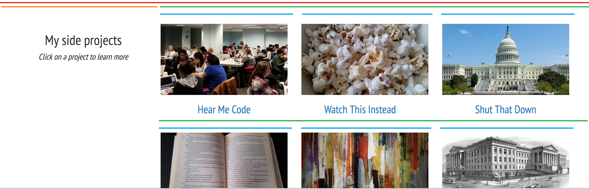
The Grid!
Notes:
Every containing element is twelve columns wide and those can all be further subdivided.
Here, in red, is the outermost container, twelve columns wide. The "My side projects" is three columns wide, shown in orange, so there are nine columns remaining, shown in green.
Bootstrap lets you further subdivide your containing elements, so I can then say, this element that's nine columns wide, Bootstrap, pretend it's twelve columns wide for a second, because I want to nest these columns inside. I don't want my projects wrapping under the "My side projects," I really like that negative space. So in green is 9 columns that we divide into 12 columns, 4 for Hear Me code, 4 for Watch this Instead, 4 for Shut That Down. And since that adds up to 12, we start a new row and divide by 4s again.
If that's confusing, don't worry! This took me a very long time to figure it all out! You will get it, in time and with practice.

Slide 50
Questions?
Ask me questions! Show me your amazing portfolio! Just say hi!
shannon@hearmecode.com

